Slide 1
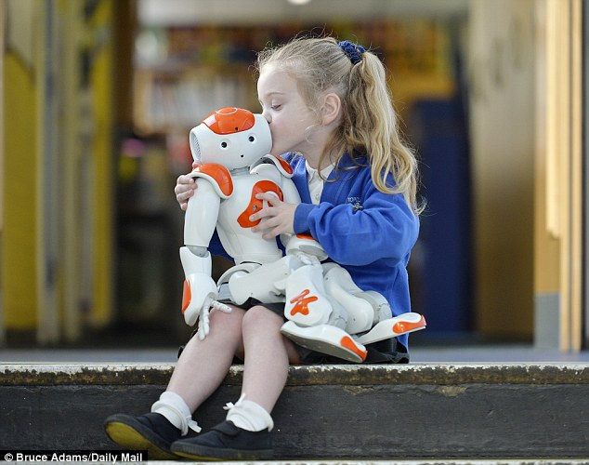
AI and society
Image soruce

Slide 2
Outline
Current concerns
Privacy
Bias and fairness
Manipulation
Medium-term concerns
Safety
AI weapons
Jobs
Long-term concerns
Superintelligence

Slide 3
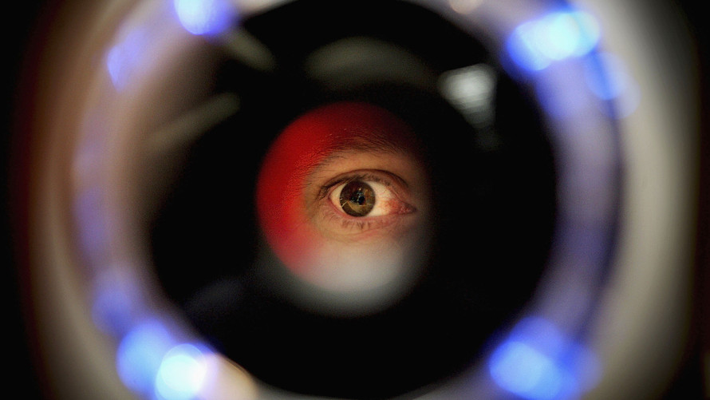
AI and privacy
Image source

Slide 4
AI and privacy
Types of data collected
Relatively insensitive: shopping, browsing, web search history, social media, personal preferences
Sensitive: face, identity, financial and medical records
Very sensitive: potentially damaging surveillance data
Entities collecting data
“Big data” companies: Facebook, Google, Apple, Amazon, etc.
Stores, employers, health ensurers, banks, etc.
Government, law enforcement, hostile parties

Slide 5
AI and privacy
Concerns
Personal data being inadvertently revealed or falling into the wrong hands
Personal data being misused by the parties who collected it
Personal data enabling individuals to be manipulated or controlled with or without their knowledge
Potential solutions
Technological: encryption, differential privacy, anonymizing tools
Regulation

Slide 6
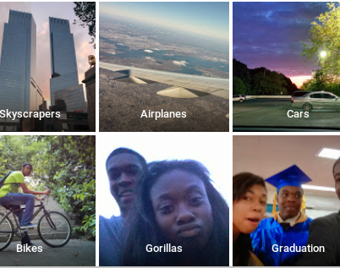
AI, bias, and fairness
https://bits.blogs.nytimes.com/2015/07/01/google-photos-mistakenly-labels-black-people-gorillas/

Slide 7
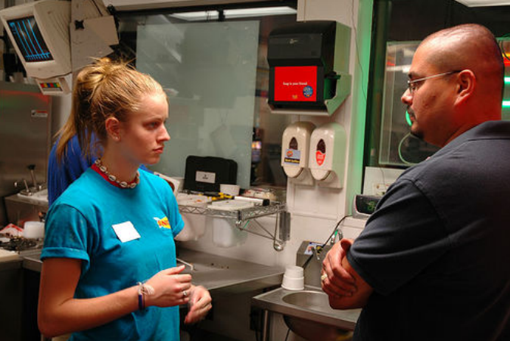
An example of biased data from my own research
“A hot, blond girl getting criticized by her boss.”
E. van Miltenburg, “Stereotyping and Bias in the Flickr30K Dataset,” Proceedings of the Workshop on Multimodal Corpora: Computer vision and language, collocated with LREC 2016

Slide 8
AI, bias, and fairness
Concerns
AI will inadvertently absorb biases from data
Making important decisions based on biased data will exacerbate bias: especially for law enforcement, employment, loans, health insurance, etc.
Even well-intentioned applications can create negative side effects: filter bubbles, targeted advertising
Outcomes cannot be appealed because AI systems are opaque and proprietary
Potential solutions
Regulation and transparency: e.g., right to explanation
More inclusivity among AI technologists: AI4ALL
Notes:
AI4ALL is a nonprofit working to increase diversity and inclusion in artificial intelligence. We create pipelines for underrepresented talent through education and mentorship programs around the U.S. and Canada that give high school students early exposure to AI for social good.

Slide 9
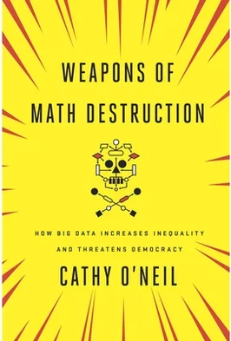
AI, bias, and fairness
Readings
AI NOW report (2017)
Weapons of math destruction
Notes:
The AI Now Institute at New York University is an interdisciplinary research center dedicated to understanding the social implications of artificial intelligence.
O’Neil is an academic mathematician turned Wall Street quant turned data scientist who has been involved in Occupy Wall Street and recently started an algorithmic auditing company.

Slide 10
AI and manipulation
Fake news
Deep Fakes

Slide 11
AI safety
Robustness to changes in data distribution
Avoiding catastrophic “corner cases”
Robustness to adversarial examples or attacks
Avoiding negative side effects in reward function
Avoiding “reward hacking”
Reading: Concrete AI safety problems

Slide 12
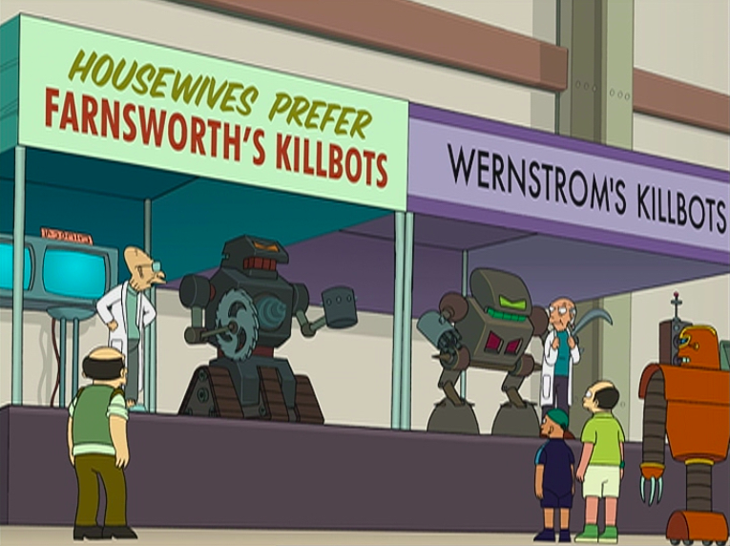
AI weapons

Slide 13
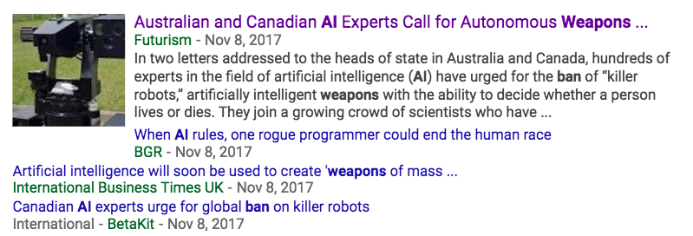
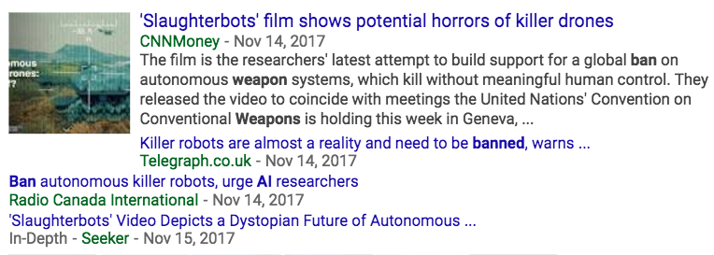

AI weapons

Slide 14
AI weapons
Reading
Robotics: Ethics of artificial intelligence (Nature, May 2015)
Humans, not robots, are the real reason artificial intelligence is scary (The Atlantic, August 2015)

Slide 15
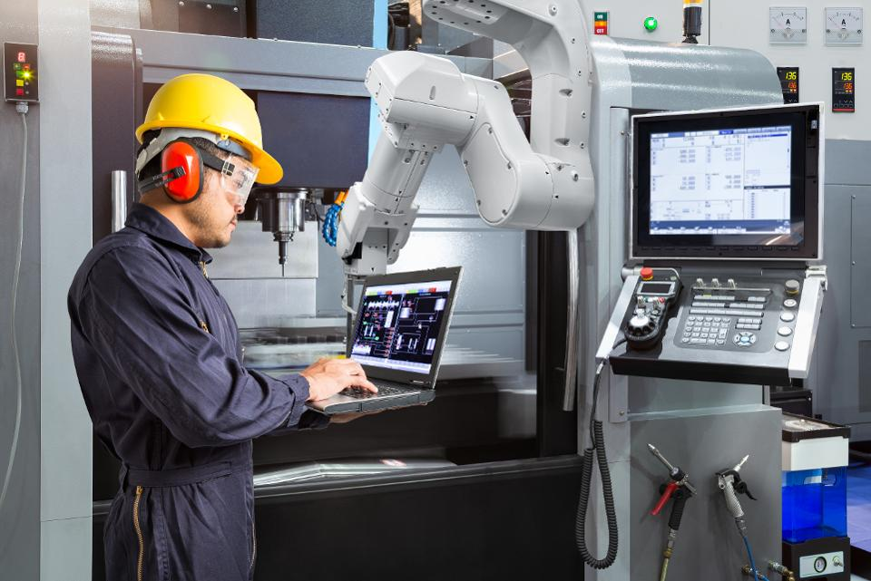
AI and jobs
Source

Slide 16
AI and jobs
Why we should worry
Oxford report: 47% of American jobs at high risk of automation in the next two decades
In the past couple of decades, manufacturing employment has dropped even as output kept rising; labor force participation among working-age males has been dropping
Truck driver is the most common job in over half the states
Why we shouldn’t worry
Productivity growth is currently low, as is business investment spending
Historically, automation has destroyed jobs but added more new jobs

Slide 17
AI and jobs
Possible solutions
Regulating automation, mandating new jobs
Policy solutions: welfare, retraining, universal basic income, redistribution of assets
More profound revolution of human values!

Slide 18
AI and jobs
Reading
Moshe Vardi talk (YouTube)
AI NOW report (2017)
Technological unemployment (Wikipedia)
A world without work (The Atlantic, July 2015)
The automation paradox (The Atlantic, Jan. 2016)
AI will transform the economy. But how much, how soon? (New York Times, Nov. 2017)
Welcoming our new robot overlords (New Yorker, Oct. 2017)
The great tech panic: robots won’t take all our work (Wired, Aug. 2017)

Slide 19
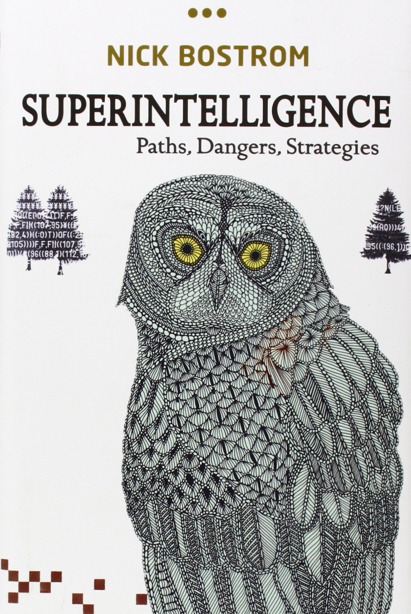
Superintelligence

Slide 20
Superintelligence
Why we should worry
Recent dramatic progress in AI – we could be at the “knee” of an exponential growth curve
No fundamental reasons why general human-level AI cannot be achieved
Positive feedback loops will kick in once a certain level of intelligence has been achieved
Historically, people have not seen disruptive innovations coming or underestimated their probability
Pascal’s wager
Notes:
From https://intelligence.org/2017/10/13/fire-alarm/
In 1901, two years before helping build the first heavier-than-air flyer, Wilbur Wright told his brother that powered flight was fifty years away.
In 1939, three years before he personally oversaw the first critical chain reaction in a pile of uranium bricks, Enrico Fermi voiced 90% confidence that it was impossible to use uranium to sustain a fission chain reaction.

Slide 21
Superintelligence
Why we shouldn’t worry
Technological obstacles to general AI are still too great (and have historically been underestimated by AI scientists)
The notion of “superintelligence” is too simplistic: intelligence is multifaceted, embodied, collective, reliant on (and limited by) the physical world
We have no evidence that recursively self-improving intelligence is possible
It is unclear why “superintelligent” AI would develop or single-mindedly pursue destructive goals
High intelligence is neither necessary nor sufficient for controlling the physical world effectively

Slide 22
Superintelligence
Readings
Superintelligence: The Idea that Eats Smart People (Maciej Ceglowski)
Discussion of “superintelligence” (Neil Lawrence)
The Myth of a Superhuman AI (Kevin Kelly)
Seven deadly sins of predicting the future of AI (Rodney Brooks)

Slide 23
AI ethics
We should be aware of all these issues when developing AI technologies!
Privacy violations
Potential for deception, misuse and manipulation
Exacerbating bias and unfair outcomes
Lack of transparency and due process
Threats to human rights and dignity
Weaponization
Unintended consequences

